Slide 1


Department of Artificial Intelligence and Data Science
Review-Driven Customer Satisfaction Prediction
Dr.P.Indira Priya,Prof
ARCHANA R M(231801011)
DEEPIKA M(231801028)

Slide 2
Problem Statement and Motivation
PROBLEM STATEMENT:
Given a dataset containing customer reviews, build a model that can predict the satisfaction rating based on the content of the review.
MOTIVATION:
Predicting satisfaction ratings from customer reviews helps businesses quickly understand customer sentiment at scale, enabling proactive improvements and enhancing customer experience.

Slide 3
Objectives
Develop a predictive model to forecast customer satisfaction ratings based on review content
Analyze key factors such as sentiment, keywords, and review length.
Improve customer experience and feedback analysis for businesses.
Enable proactive measures to address dissatisfaction and enhance service quality.

Slide 4
Abstract
This project builds a predictive model to analyze customer satisfaction using hotel review data.
Positive and negative textual reviews are preprocessed and converted into numerical embeddings.
Logistic Regression is used for classification due to its interpretability and simplicity.Customer satisfaction scores are categorized into binary classes for model compatibility.
Data visualization aids in understanding review patterns and correlations.The model provides actionable insights to enhance customer experience and business outcomes.

Slide 5
Introduction and Overview of the Project.
Predicting customer satisfaction from review content is vital for businesses to improve services and meet customer needs.
By analyzing text data, we can identify trends and sentiments influencing satisfaction ratings.
Using machine learning and natural language processing (NLP), we can develop a model that learns from historical reviews and their associated ratings, enabling it to predict satisfaction levels for new reviews.
This approach offers valuable insights for businesses to enhance customer experiences and make informed decisions.

Slide 6
Existing System
1. Traditional Models
Logistic Regression & SVM: Effective with TF-IDF or bag-of-words features.
2. Deep Learning Models
RNNs / LSTMs: Capture text context, improving accuracy for sentiment prediction.
CNNs: Extract spatial features from text data.
3. Transformer Models
BERT and Similar: State-of-the-art, high accuracy by understanding sentence context.

Slide 7
Drawback of Existing System
1. Traditional Models (Logistic Regression, SVM)
Limited understanding of context in reviews.
Less effective with complex language patterns.
2. Deep Learning Models (RNNs, LSTMs, CNNs)
Require large datasets and high computational power.
Struggle with long-term dependencies and context.
3. Transformer Models (BERT and similar)
High resource demands (memory, processing power).
Time-consuming fine-tuning, especially with limited data.

Slide 8
Proposed System
Data Collection: Utilize customer feedback in the form of positive and negative reviews, along with satisfaction scores.
Data Preprocessing: Clean text data, tokenize reviews, convert them into numerical embeddings, and prepare satisfaction scores for binary or multi-class classification.
Algorithm Choice: Use Logistic Regression for its simplicity and interpretability, with feature embeddings derived from textual reviews.
Model Evaluation: Assess the model using accuracy, precision, recall, F1-score, and ROC-AUC metrics.
Model Evaluation: Assess the model using accuracy, precision, recall, F1-score, and ROC-AUC metrics.

Slide 9
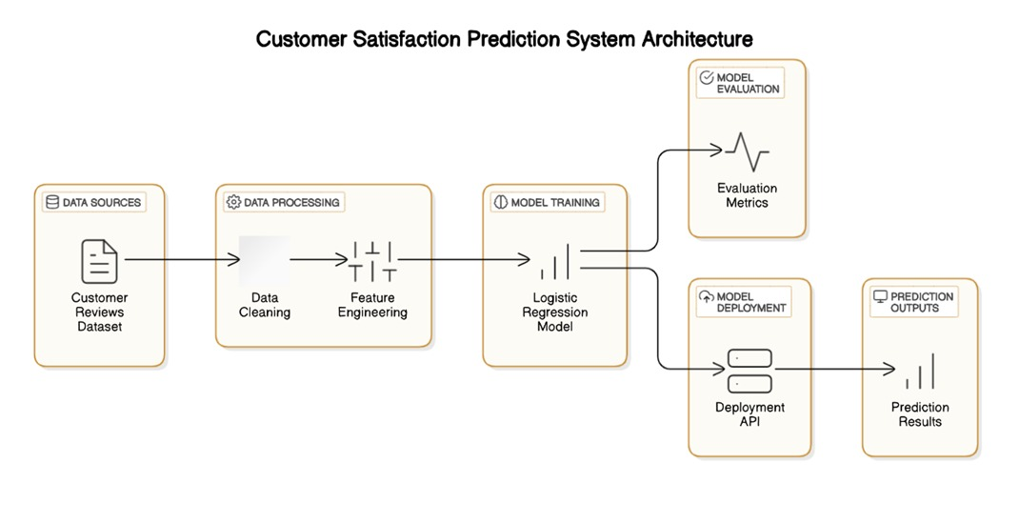
System Architecture

Slide 10
Modules
This project aims to predict customer satisfaction levels based on hotel reviews through a series of modules. These include Data Collection and Preprocessing and Model Development, Training, and Evaluation. Each module plays a crucial role in gathering, analyzing, and utilizing customer feedback to enhance service quality and improve the overall customer experience, providing an efficient end-to-end solution for hospitality management.
There are two modules in the proposed system:
Data Collection and Preprocessing
Model Development, Training, and Evaluation

Slide 11
Module 1-Data Collection and Preprocessing
Collect Data: Gather positive and negative customer reviews along with satisfaction ratings (target variable).
Text Cleaning: Remove irrelevant characters, convert text to lowercase, and eliminate stopwords.
Tokenization: Split text into smaller units (words or sub-words) for feature extraction.Text Vectorization: Convert tokens into numerical embeddings using methods like Word2Vec or Sentence-BERT.
Handle Missing Data: Impute or discard missing values in reviews and satisfaction ratings.

Slide 12
Module 2-Model Development, Training, and Evaluation
Model Choice: Use Logistic Regression for its simplicity and suitability for binary/multi-class classification.
Feature Selection: Identify important features (embeddings) that contribute most to predicting satisfaction.
Training: Train the model using review embeddings and satisfaction ratings, with cross-validation and hyperparameter tuning.
Evaluation Metrics: Assess model performance using accuracy, precision, recall, F1-score, and ROC-AUC.
Model Improvement: Fine-tune the model based on evaluation results, and deploy for real-time predictions if performance is satisfactory.

Slide 13
Conclusion
Developed a Logistic Regression model to predict customer satisfaction from review text, achieving high accuracy.
Provided actionable insights for businesses to improve customer experience.Faced challenges with ambiguous or mixed reviews, revealing limitations in handling nuanced feedback.
Identified opportunities for improvement through advanced NLP techniques and more diverse datasets.
Proposed future enhancements including deep learning integration, real-time prediction, and ethical safeguards for a scalable, robust system.

Slide 14
References.
Jankins, R. M., & Walts, R. E. (1968). Principles of Machine Learning Algorithms. McGraw-Hill, New York.
2. Shin, H. J., et al. (1984). "A Study on Mechanical Manipulators." Journal of Robotic Systems, 10(5), 765-779.
3. Shin, H. J., & Choi, H. (1984a). "Limitations in Robotic Manipulation Techniques." Journal of Robotic Systems, 11(2), 98-102.
4. Tsuchiya, K. (1980). "Improved Algorithm for Signal Processing." International Journal of Signal Processing, 22(3), 345-358.

Slide 15
Thank You

